Slide 1
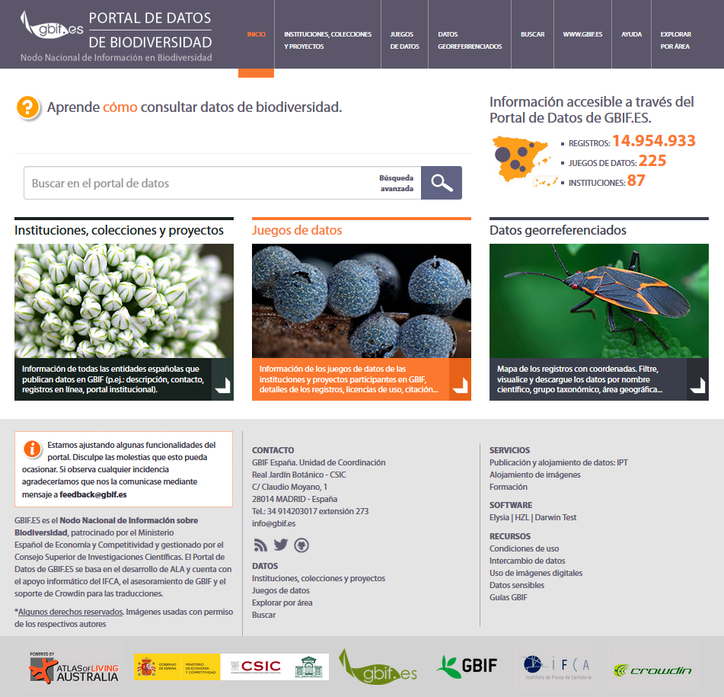
CURRENT STATUS OF ATLAS OF LIVING SPAIN
2017 European GBIF Nodes Meeting
Cristina Villaverde Santiago Martínez de la Riva
villaverde@gbif.es sama@gbif.es
GBIF.ES

Slide 2
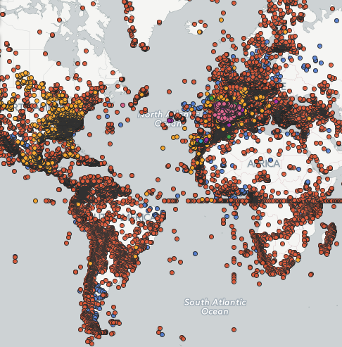
Background
Launched in 2014, first Node in developing national data portal based on ALA technology
Built on 13 virtual machines
Hosted in IFCA, national centre of the European Grid Initiative (EGI)
23 millon records available on the GBIF.ES Atlas
Full internationalization of ALA portal (focused on java script files)
Assistance of Dave Martin
Support to Luxembourg, Andorra, Portugal, Catalonia
http://datos.gbif.es/
Notes:
Full internationalization of ALA portal (focused on java script files)

Slide 3
Already in Pre-Production Mode
Index, Search and Registry systems updated
It was essential to update these modules in order to make further developments as many changes have been done since we implemented ALA in 2014. This will allow to index datasets with images or other multimedia objects.
Regions Module
Explore occurrence records associated with regions such as political regions, territorial limits, biogeographic regions, marine regions, protected areas, land use divisions, etc.
Species information
Publish and show information about species and link them to correspondent species lists.
Notes:
New developments in Pre-Production mode

Slide 4
Next steps
Interaction between IPT and ALA
Common structure between IPT and datasets pages (collectory) in ALA so all fields in DwC Archive could be displayed.
Species information in Plinian Core
Display species information in Plinian Core standard (https://github.com/tdwg/PlinianCore) in the ALA portal. Interoperability.
GBIF Backbone
Using the GBIF Backbone Taxonomy as the reference names list to index records. More efficient index process. http://www.gbif.org/dataset/d7dddbf4-2cf0-4f39-9b2a-bb099caae36c
Notes:
New developments
Common structure between IPT and datasets pages (collectory) in ALA so all fields
Common structure between IPT and datasets pages on ALA

