Slide 2
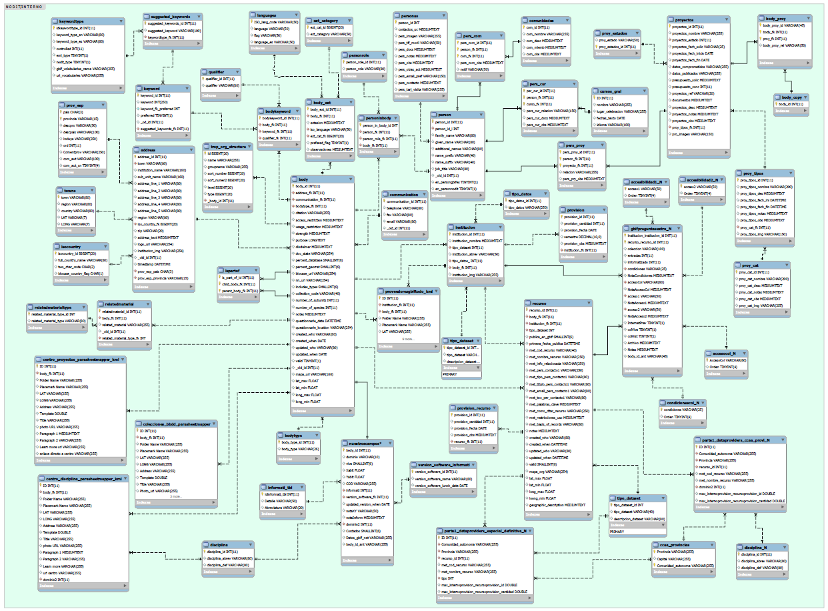
E/R MODEL:
Nodit_2_ok
interno
t_body
t_institution,
t_recurso …
t_pers_cur
t_course
webgbif
course
Relation between Databases

Slide 3
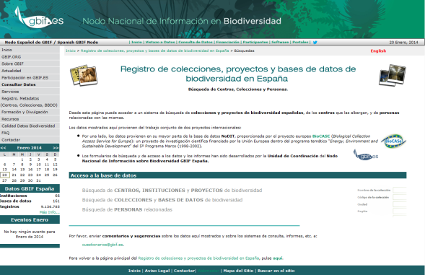
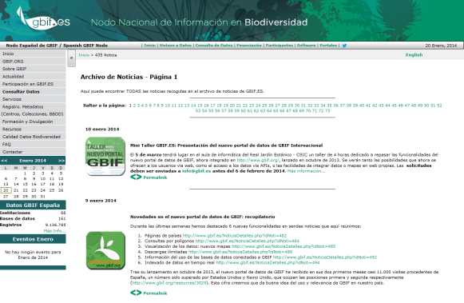
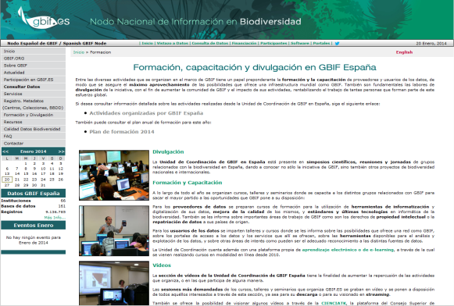
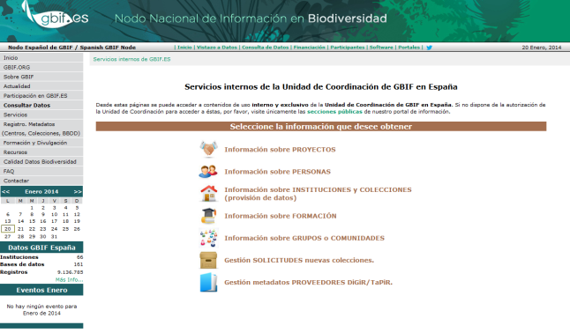
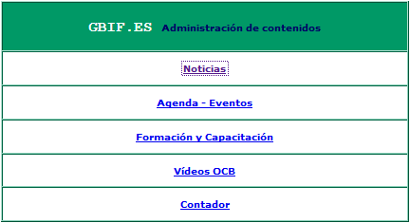
DB NODIT_2_OK
DB WEBGBIF
DB COURSE / VIDEOS
http://www.gbif.es/ic_busquedas.php
http://www.gbif.es/noticias.php
http://www.gbif.es/Formacion_ppal.php
DB INTERNO
ADMINISTRATION
http://www.gbif.es/interno
http://www.gbif.es/Formacion_ppal.php

Slide 4
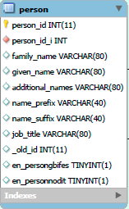
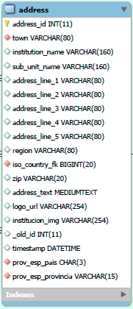
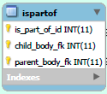
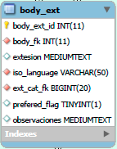
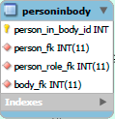
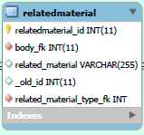
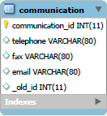
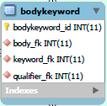
Database-nodit
DB NODIT_2_OK
http://www.gbif.es/ic_busquedas_in.php

Slide 5
Database-noditk
Institution/Organization/Centre
(parent_body_fk)
Father (body_id)
Collection (Virtual)
Collection (Virtual)
Collection (Virtual)
(child_body_fk)*
Sons (body_id)
Collection (Virtual)
Collection (Virtual)
Resources
(body_fk)*
grandson (resource_id)

Slide 6
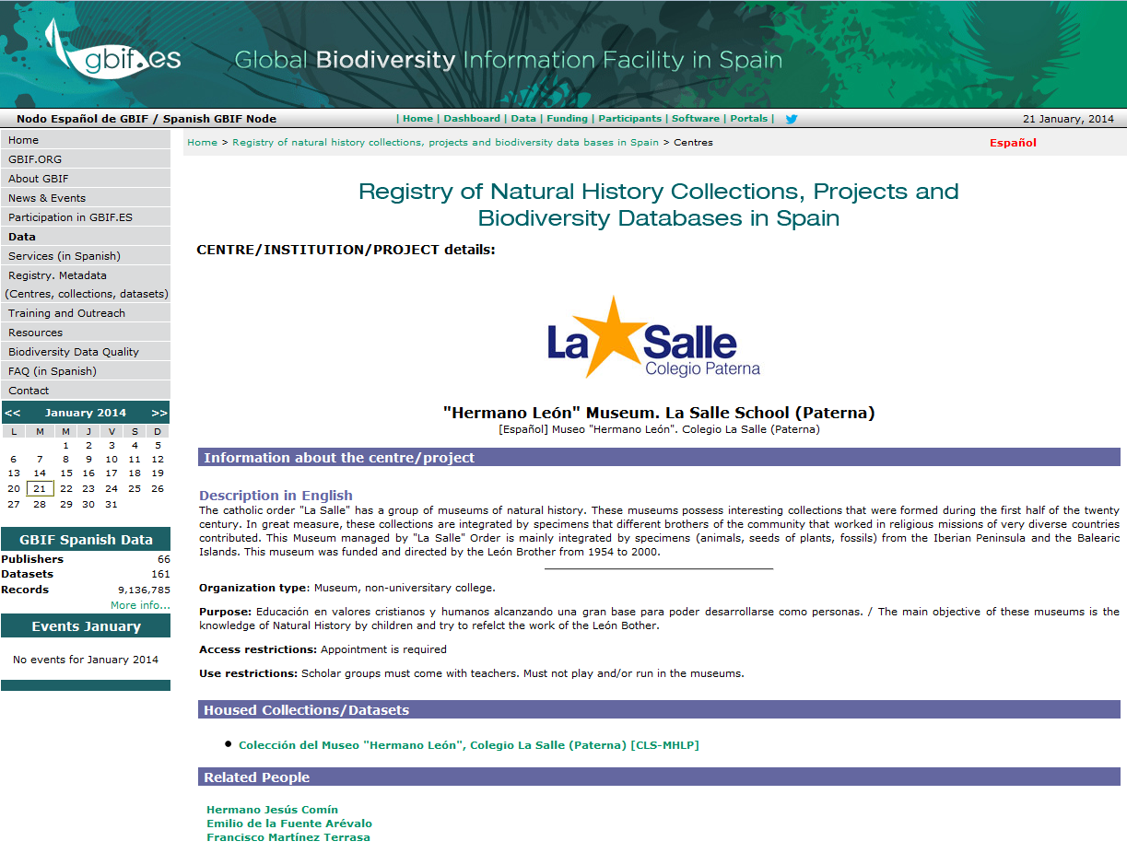
Database-noditk: Intitution/Centre/Orga
http://www.gbif.es/ic_centros_in.php?ID_Centro=9761

Slide 7
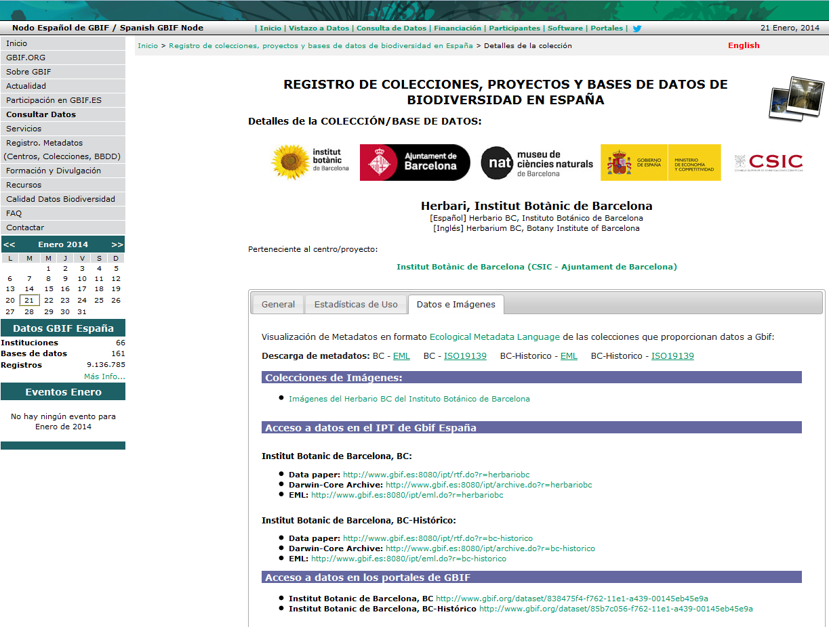
Database-noditk: Collection and resources
http://www.gbif.es/ic_colecciones.php?ID_Coleccion=9752

Slide 8
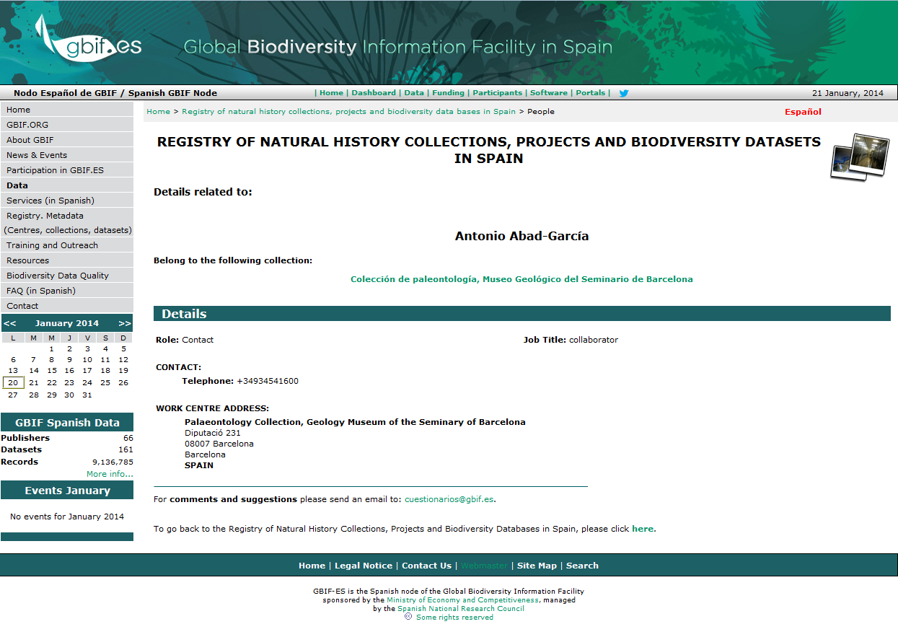
Database-noditk:
http://www.gbif.es/ic_personas_in.php?ID_Persona=365

Slide 9
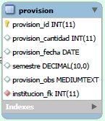
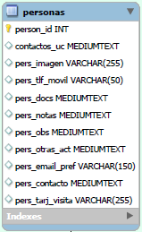
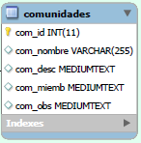
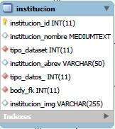
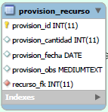
Database-interno
DB INTERNO
http://www.gbif.es/interno

Slide 10
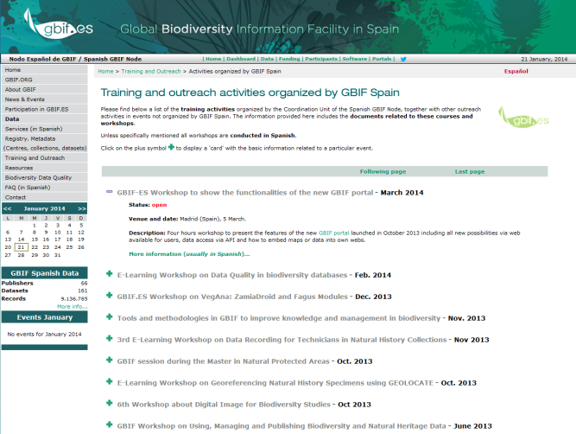
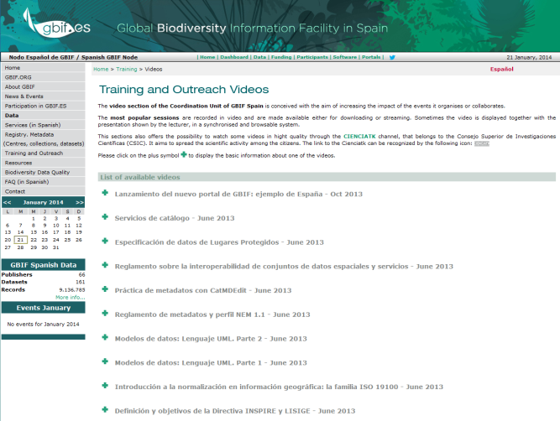
Database-Course: Training
http://www.gbif.es/formacion_in.php
http://www.gbif.es/videos/videos_in.php
http://www.gbif.es/formaciondetalles.php?IDForm=123
http://www.gbif.es/videos/video_detall_in.php?IDVideo=216

Slide 11
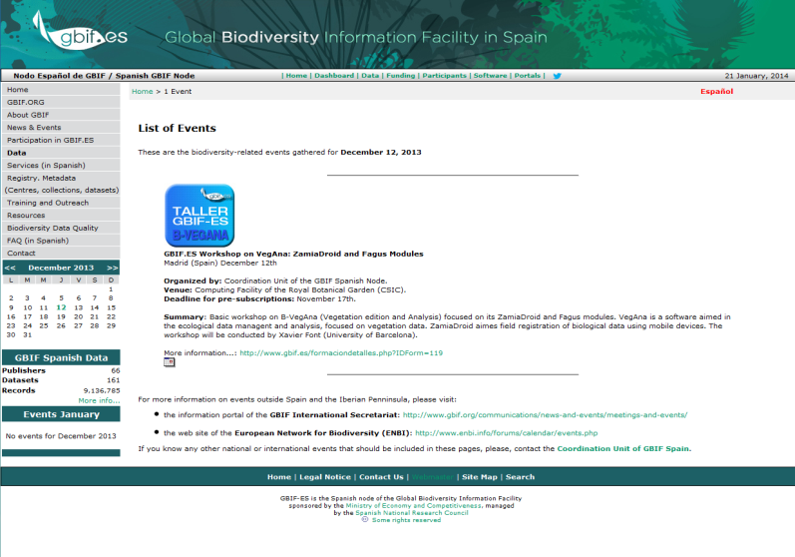
Database-webgbif
http://www.gbif.es/Noticias_in.php
http://www.gbif.es/Listado_in.php?fecha=2013-12-12

Slide 12
THANK YOU

