Slide 1
International Living Atlases Workshop
Madrid 2018
Atlas of Living Australia - Introduction
Nick dos Remedios & Dave Martin

Slide 2
About the ALA
Established in 2008 (10 year birthday!)
Funded by the Australian Federal Government via the “National Collaborative Research Infrastructure Strategy” (NCRIS)
  NCRIS supports national research capability through 27 active projects and is comprised of 222 institutions employing over 1700 technical experts, researchers and facility managers. NCRIS facilities are used by over 35,000 researchers, both domestically and internationally
Hosted by CSIRO (Australia’s national research organisation)
Ongoing funding into the future (~$3 million/yr)
~25 staff & ~half are developers/data analysts
GBIF Australia

Slide 3
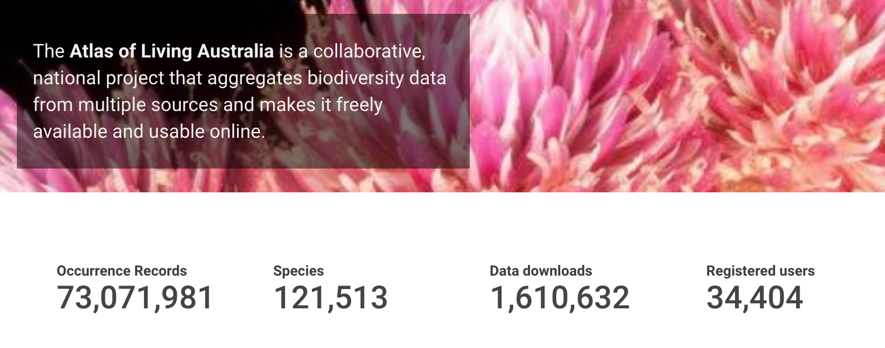
What do we do?
Names & taxonomy (BIE)
Aggregate occurrence records (Biocache)
Datasets, collections, institutions, etc... metadata (Collectory)
Citizen Science - BioCollect & DigiVol
Lists, Dashboard, Spatial Portal, Regions, Specimens, Image service, Profiles & everything else

Slide 4
Open Source & Open Access
All code is open source and available via GitHub:
https://github.com/AtlasOfLivingAustralia
ALA infrastructure is free to run (no commercial dependencies)
Linux installation
Creative Commons 3.0 attribution

Slide 5
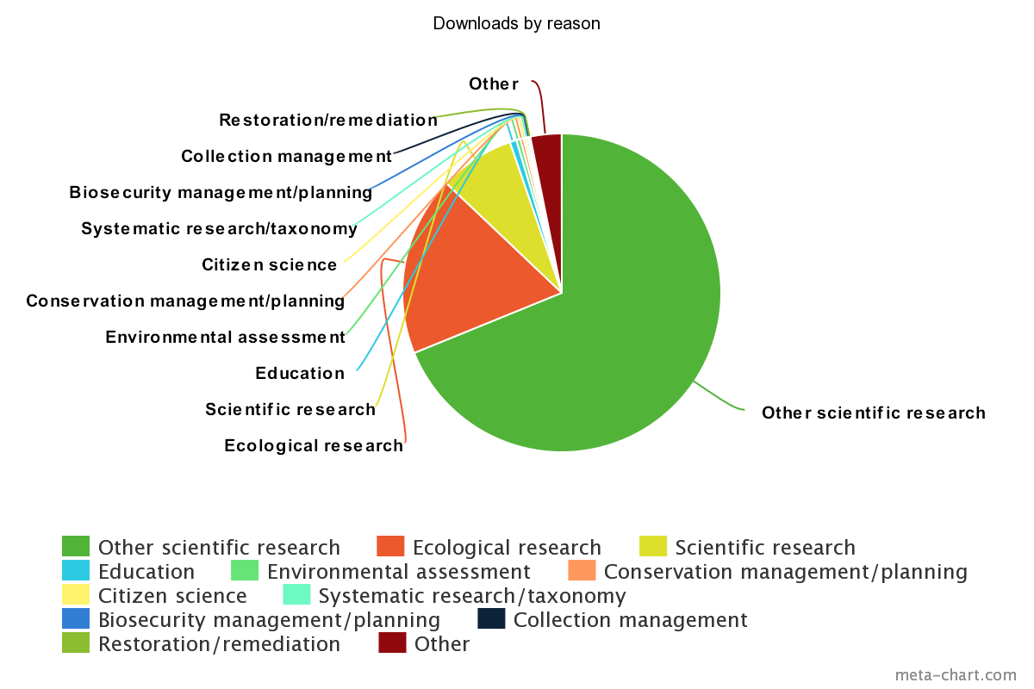
Who are our user?

Slide 6
Roadmap
Continued maintenance & improvement
  Grails 3, BS3, JDK8, Ansible scripts
  more tests - unit & functional
Implement UX review recommendations
  role-based design - drive users to the pages and interfaces that best
  layered design - filter the UI to show/hide complex features, depending on the “role”
DOIs on downloads (released soon) and on other data (datasets, PDFs, field guides, checklists, etc.)
Web services to use OpenAPI (Swagger)

