Slide 1
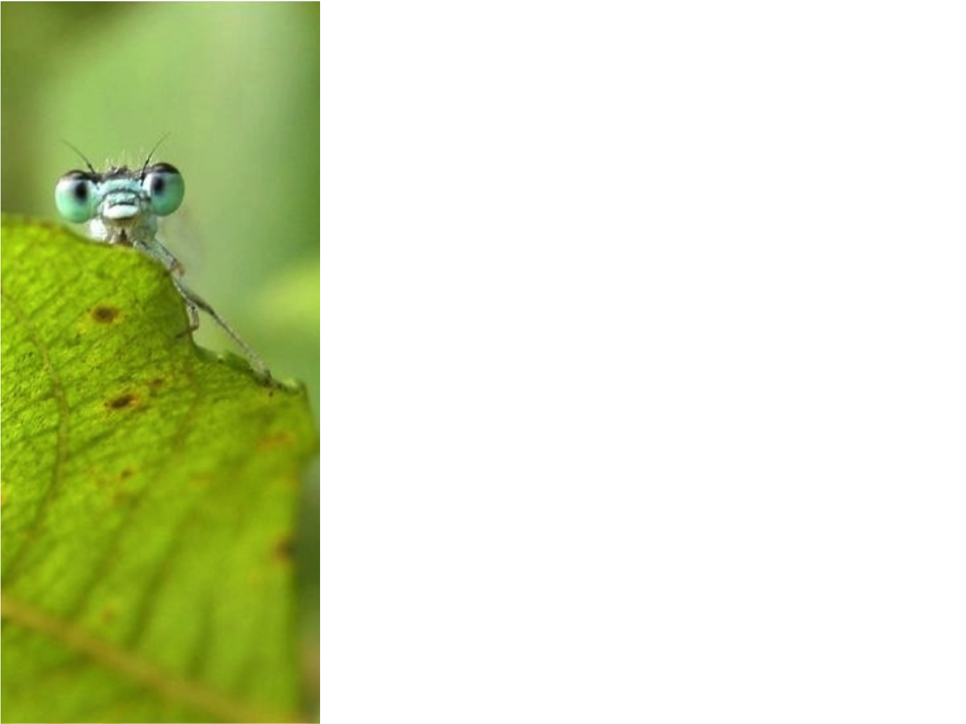
Living Atlases community
International Living Atlases community 19/02/2018 - Madrid, Spain
Marie-Elise Lecoq
Lead developer, GBIF France
melecoq@gbif.fr

Slide 2
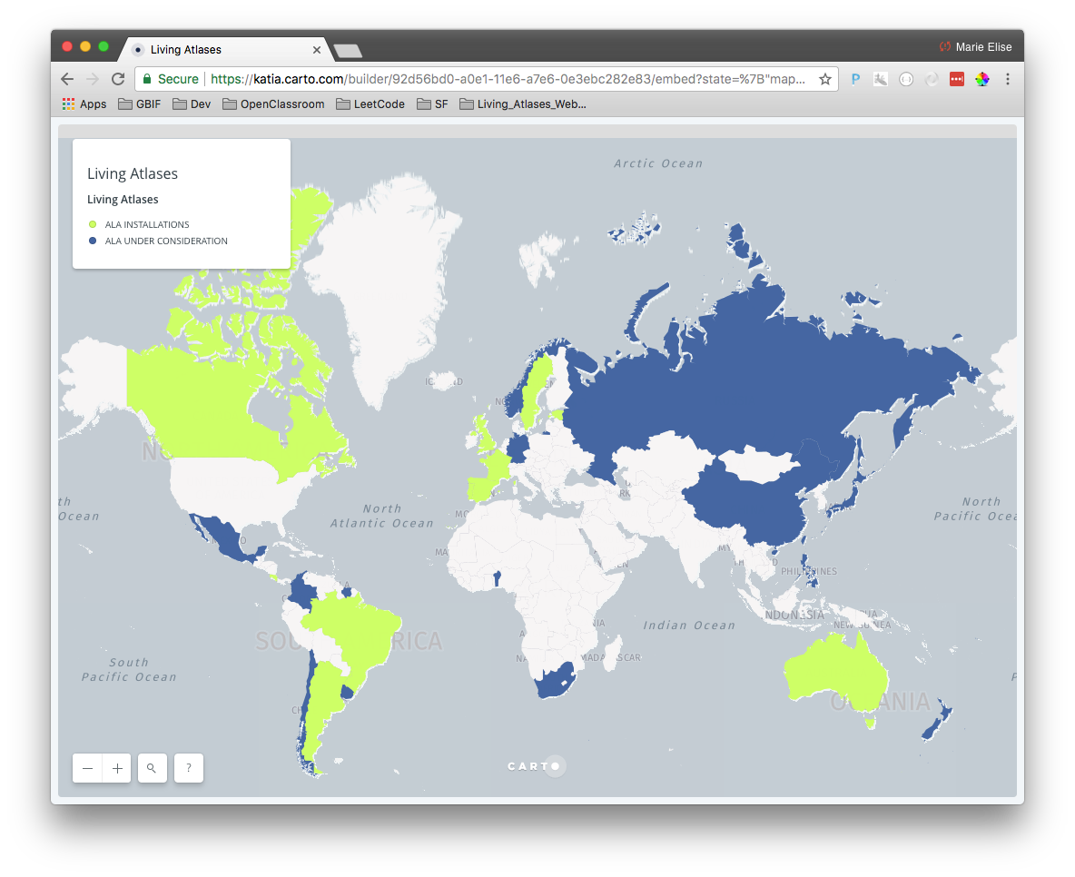
Countries involved
Community
Map created by Katia Cezón, GBIF Spain – https://tinyurl.com/ydc78p86

Slide 3
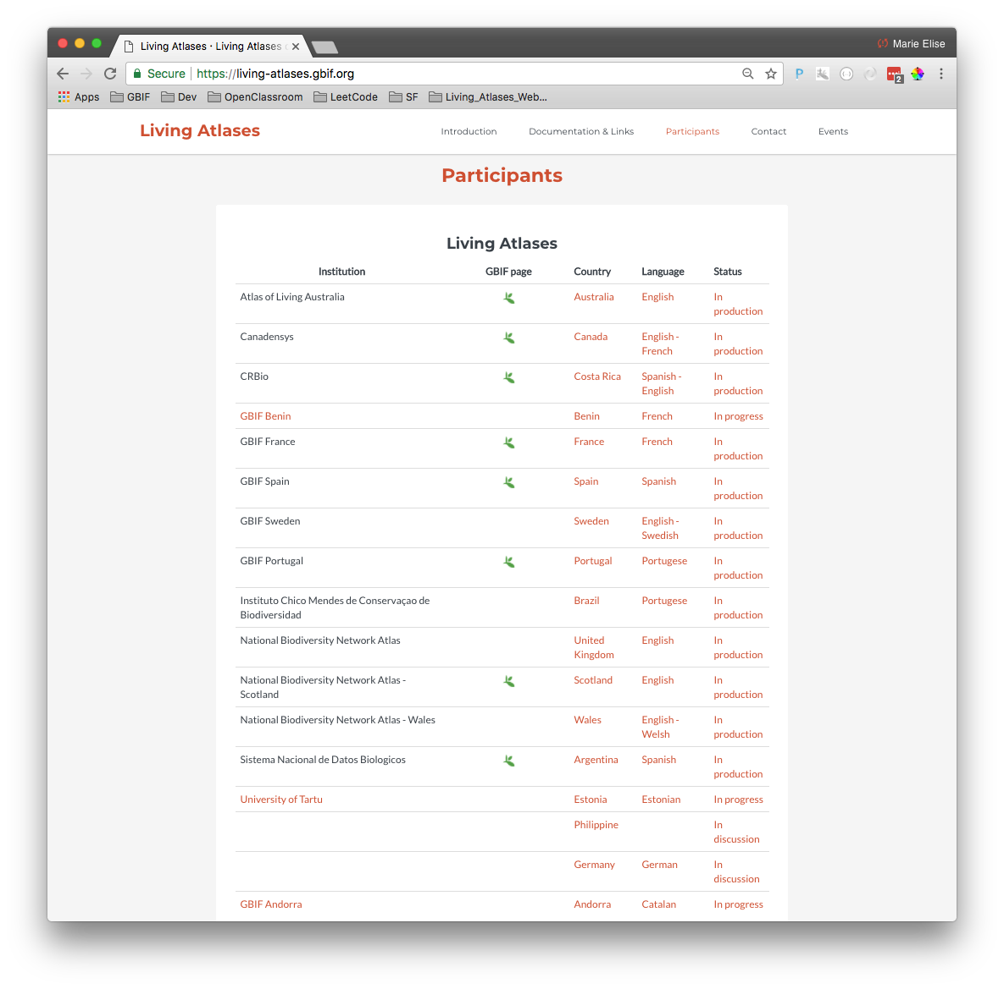
Living Atlases community
Community
Notes:
Ajouter des noms

Slide 4
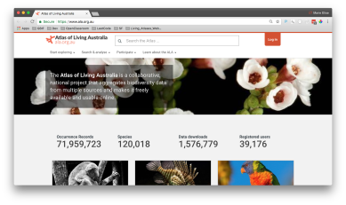
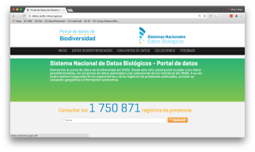
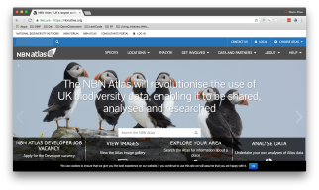
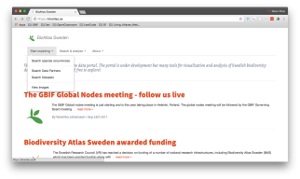
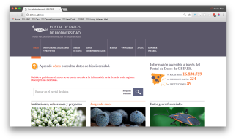
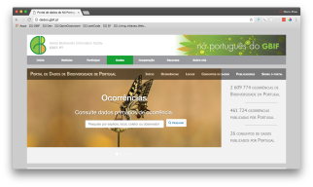
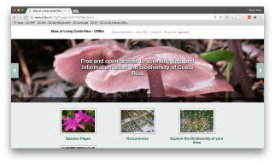
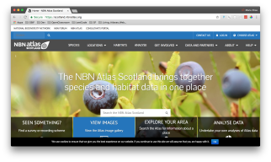
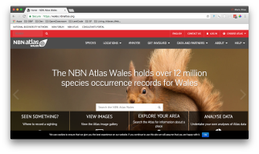
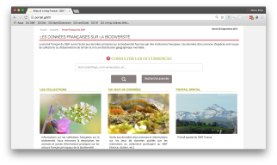
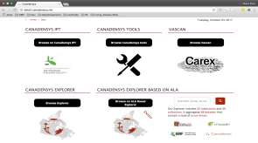
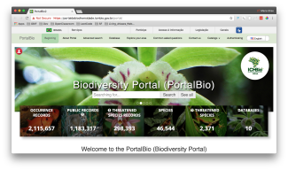
Portals in production
Community
Notes:
Vérifier les screenshots

Slide 5
Communication
Mailing List
ala.portal@lists.gbif.org
Registration: http://lists.gbif.org/mailman/listinfo/ala-info
HipChat Room (for developers)
Public access: https://www.hipchat.com/gx1ej3K6Q
Documentation
ALA Key Technical Document http://www.gbif.org/project/2015-ala-internationalization
Documentation wiki in the ALA GitHub https://github.com/atlasoflivingaustralia/documentation/wiki
Community

Slide 6
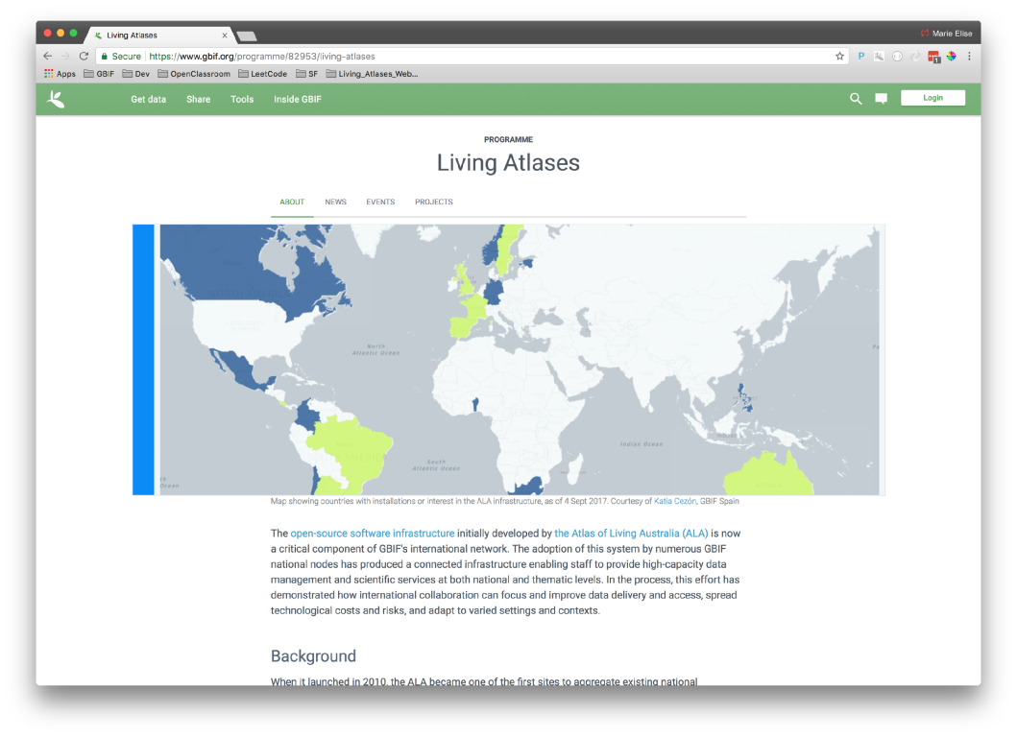
GBIF Programme page
Community
https://www.gbif.org/programme/82953/living-atlases

Slide 7
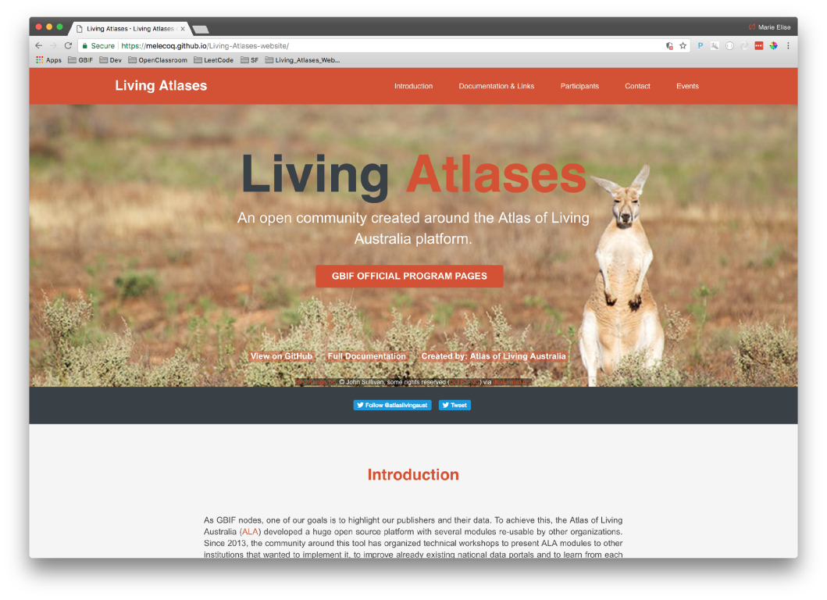
Living Atlases community
Community
https://living-atlases.gbif.org

Slide 8
2017 / 2018
CESP Project :
CESP Regional event to organize the 1-week workshop in Feb 2018 in Madrid (current).
CESP Mentoring between Canadensys and GBIF France to help open the community to French-speaking countries.
CESP Mentoring between GBIF Benin and GBIF France to install the Beninese data portal based on ALA
TDWG 2018 :
1-session workshop around Atlas of Living Australia tools with demonstrations
Collaboration
GBIF Argentina has begun to help installing ALA in Colombia.
GBIF Spain has begun to work on the installation of the ALA portal in GBIF Andorra and GBIF Luxemburg.
Community
Notes:
.

Slide 9
Project call 2018/2019
CESP calls:
CESP “Usage of the Canadensys and GBIF data portals: how to prepare your data, and reuse them on national and international platforms” between Canadensys and GBIF Spain (workshops).
CESP between GBIF France and GBIF Togo to install the Togolese data portal based on ALA.
CESP Living Atlases community with two focus:
Documentation in the form of video tutorials and exercises in different languages.
Regional event to organize the 1-week workshop between April – June 2019 in France.
Community
Notes:
.

Slide 10
Future…
More technical workshops (at least one per year) focused on different modules of the platform (Species list, Spatial, etc.) and for different levels (beginners and advanced)
More GBIF participants will launch their portals in production: Andorra, Benin, Luxembourg, Mexico, etc.
Improvement of the communication between participants (project calls, helpdesk, bug report, etc.)
Answer project calls to fund our technical workshops.
Conclusion

Slide 11
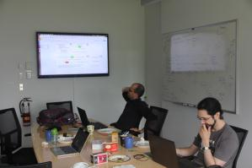
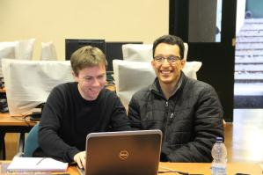
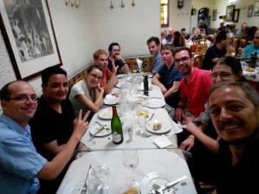
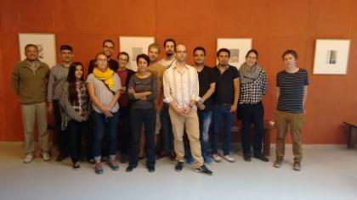
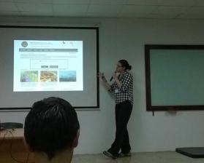
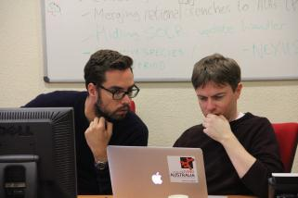
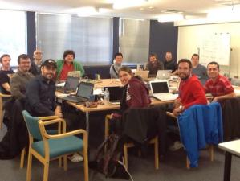
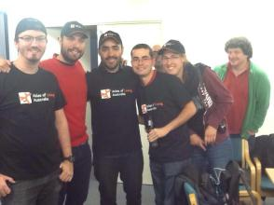
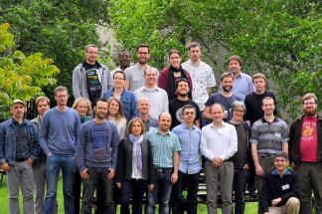
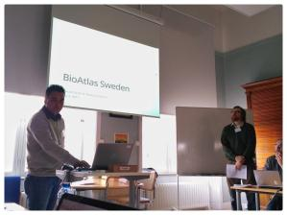
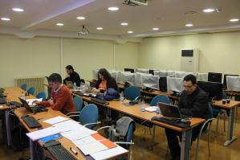
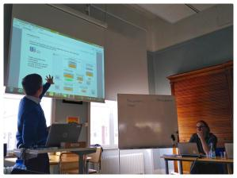
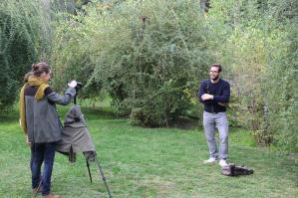
Thank you !
Conclusion

