Slide 1
Data Hubs
Supporting co-development between GBIF nodes
GBIF CESP Workshop, Madrid 2018
Dave Martin

Slide 2
Data hubs
What is a data hub?
Examples in Australia
UK model

Slide 3
Data hub
A front end to ALA
Showing a subset of the data
Split by:
Region
Taxonomy
Basis of record - e.g. Specimens only
Temporal
Or any query…..

Slide 4
Sharing (is caring)
ALA supports a ”hub” model
1 infrastructure, lots of (pretty) faces
Hubs can be regional, taxonomic, thematic
Nodes can share:
Developer time - collaboration
Infrastructure costs / maintenance

Slide 5
Australia examples
https://collections.ala.org.au/dataHub/list

Slide 6
UK Model
One infrastructure
Supports 4 portals - more coming
Consists of
Occurrence search (Biocache)
Species pages (BIE)
Regions
Spatial portal

Slide 7
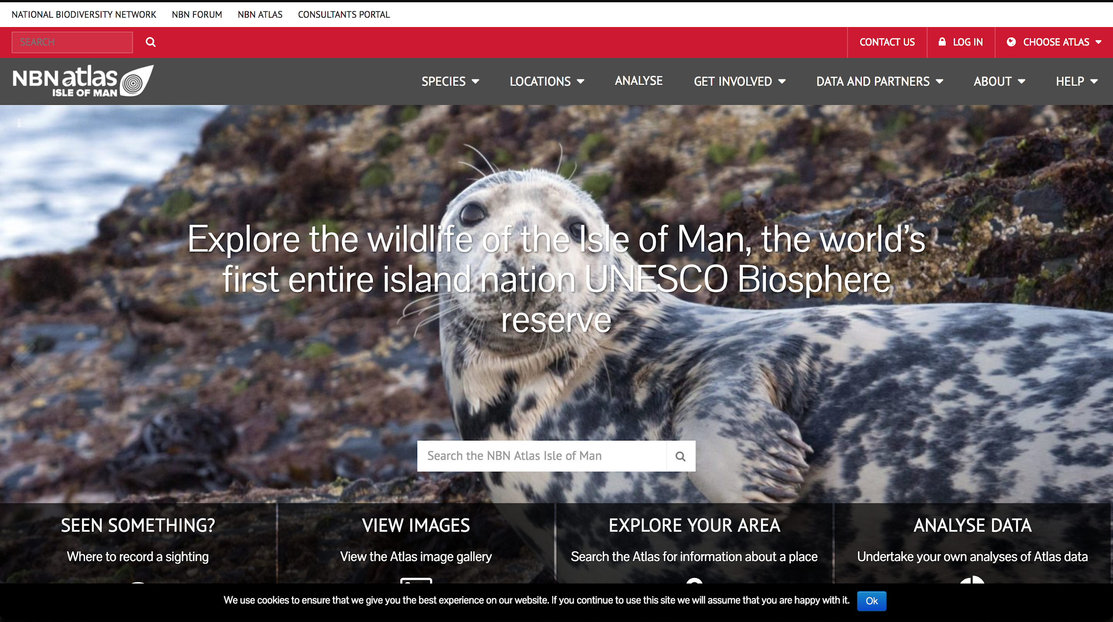
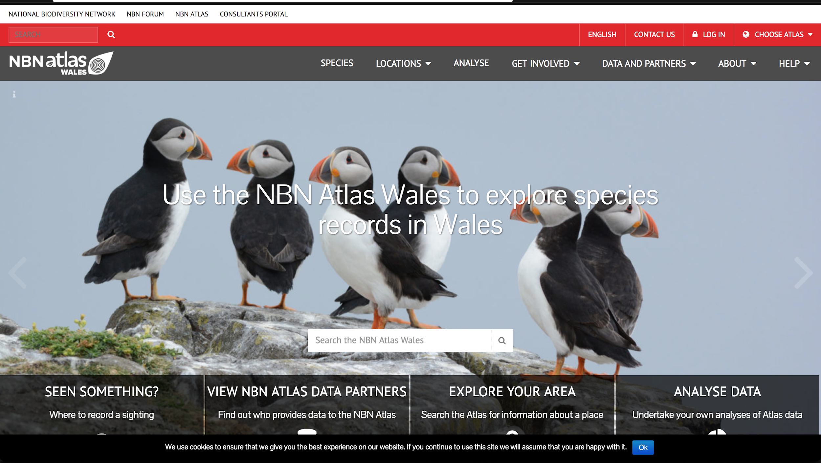
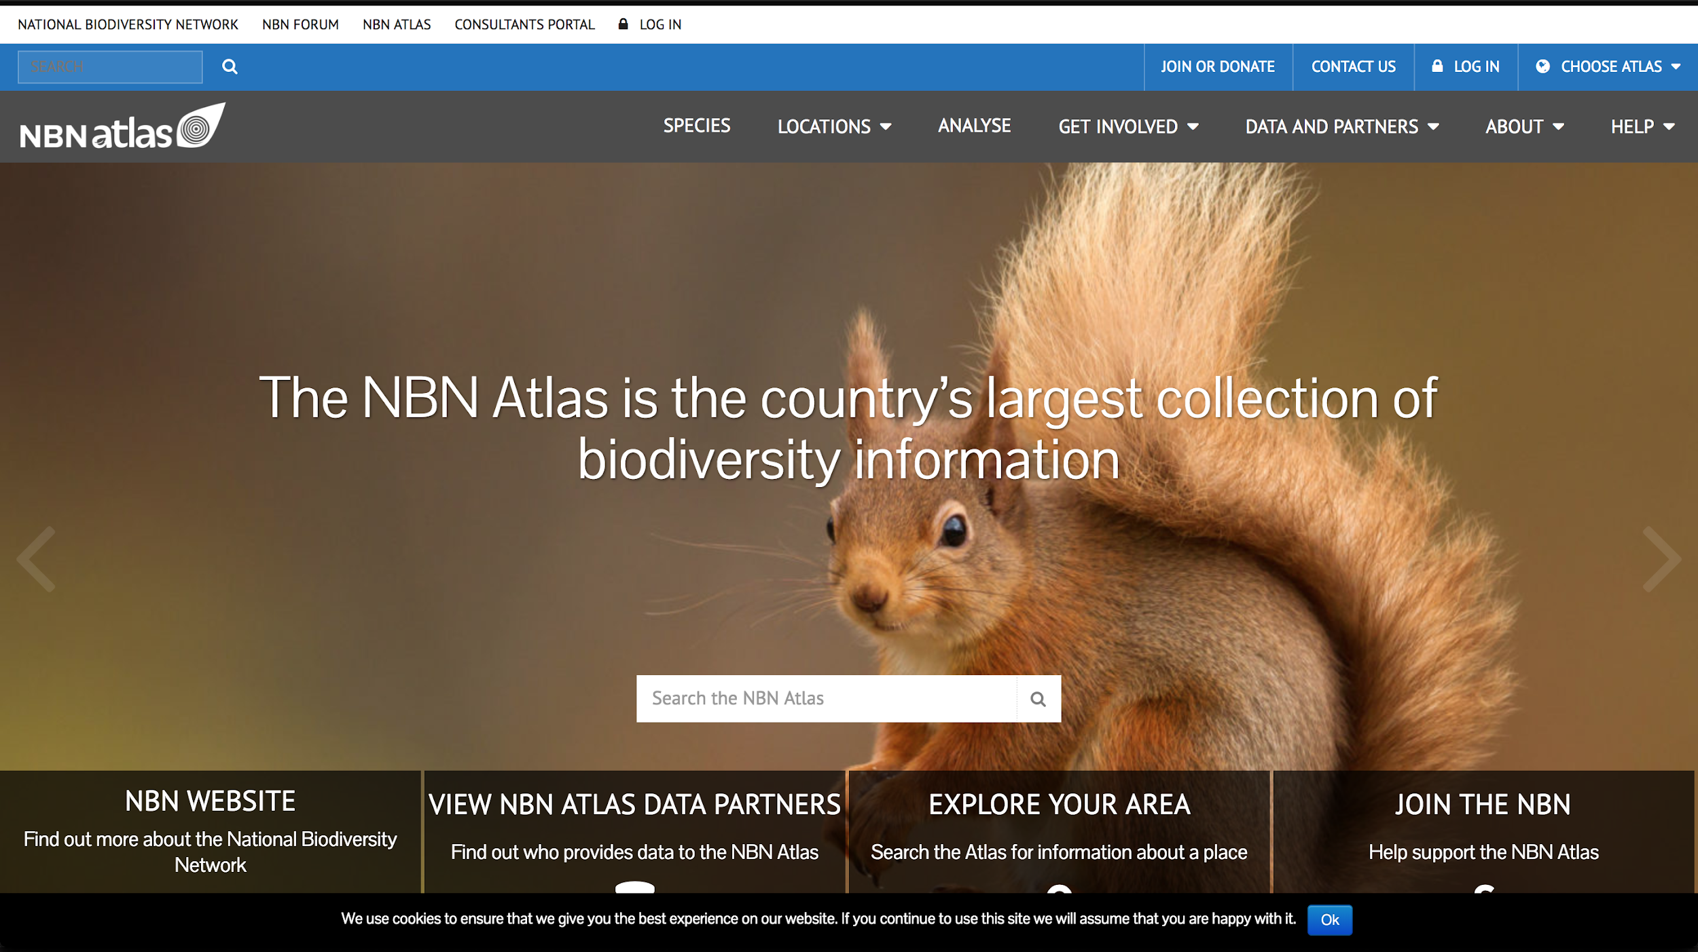
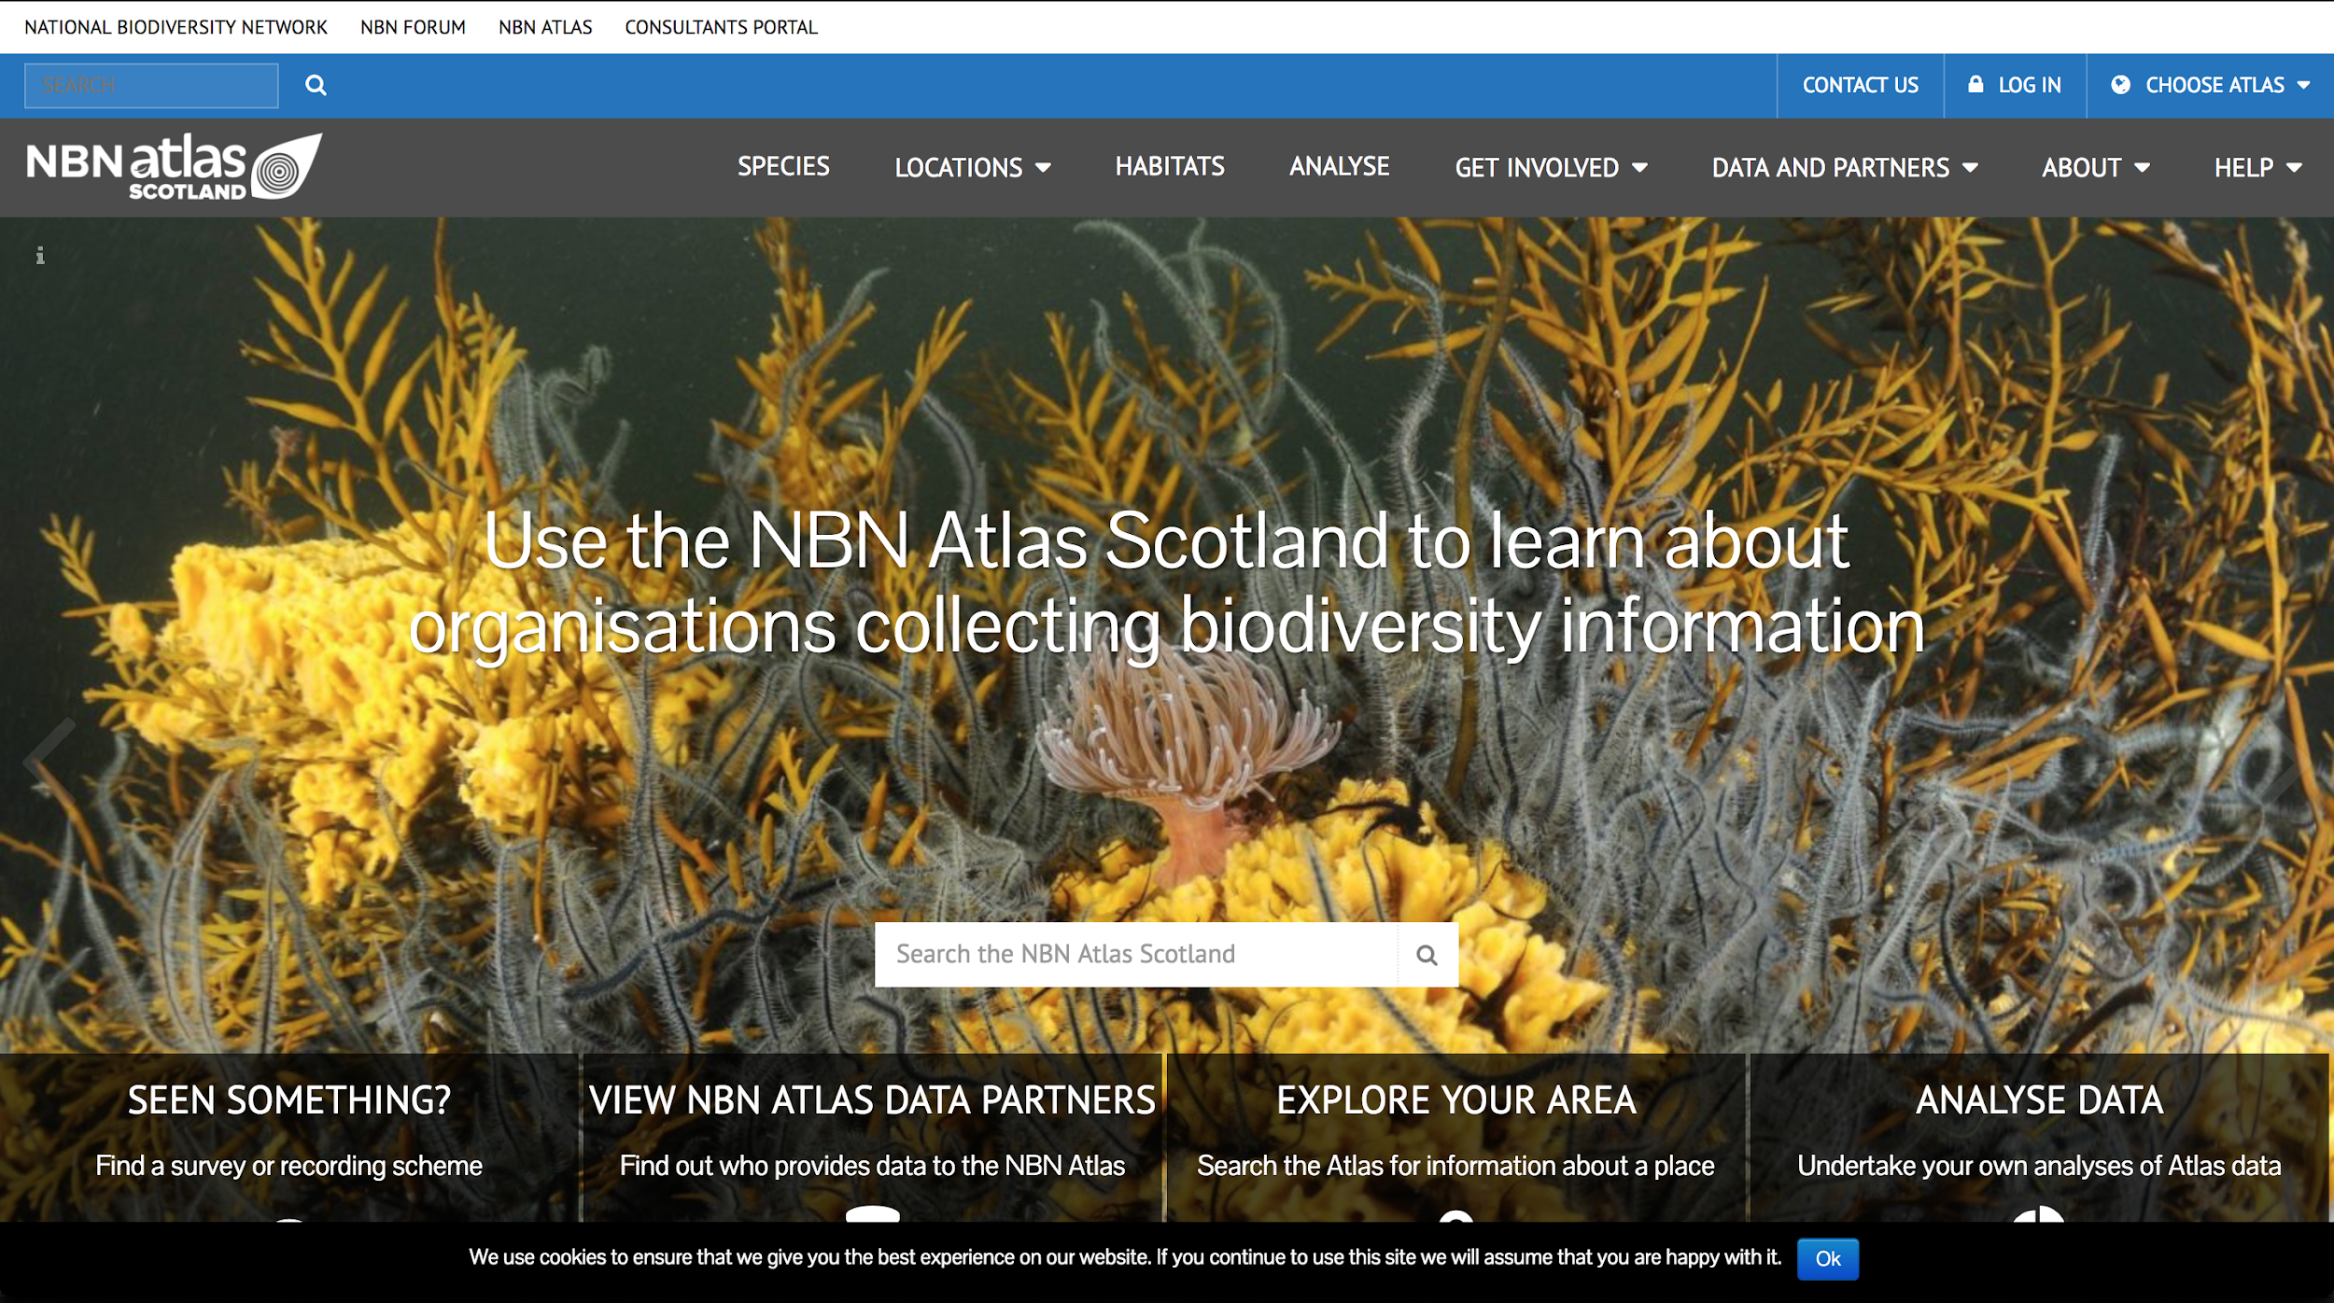

Slide 8
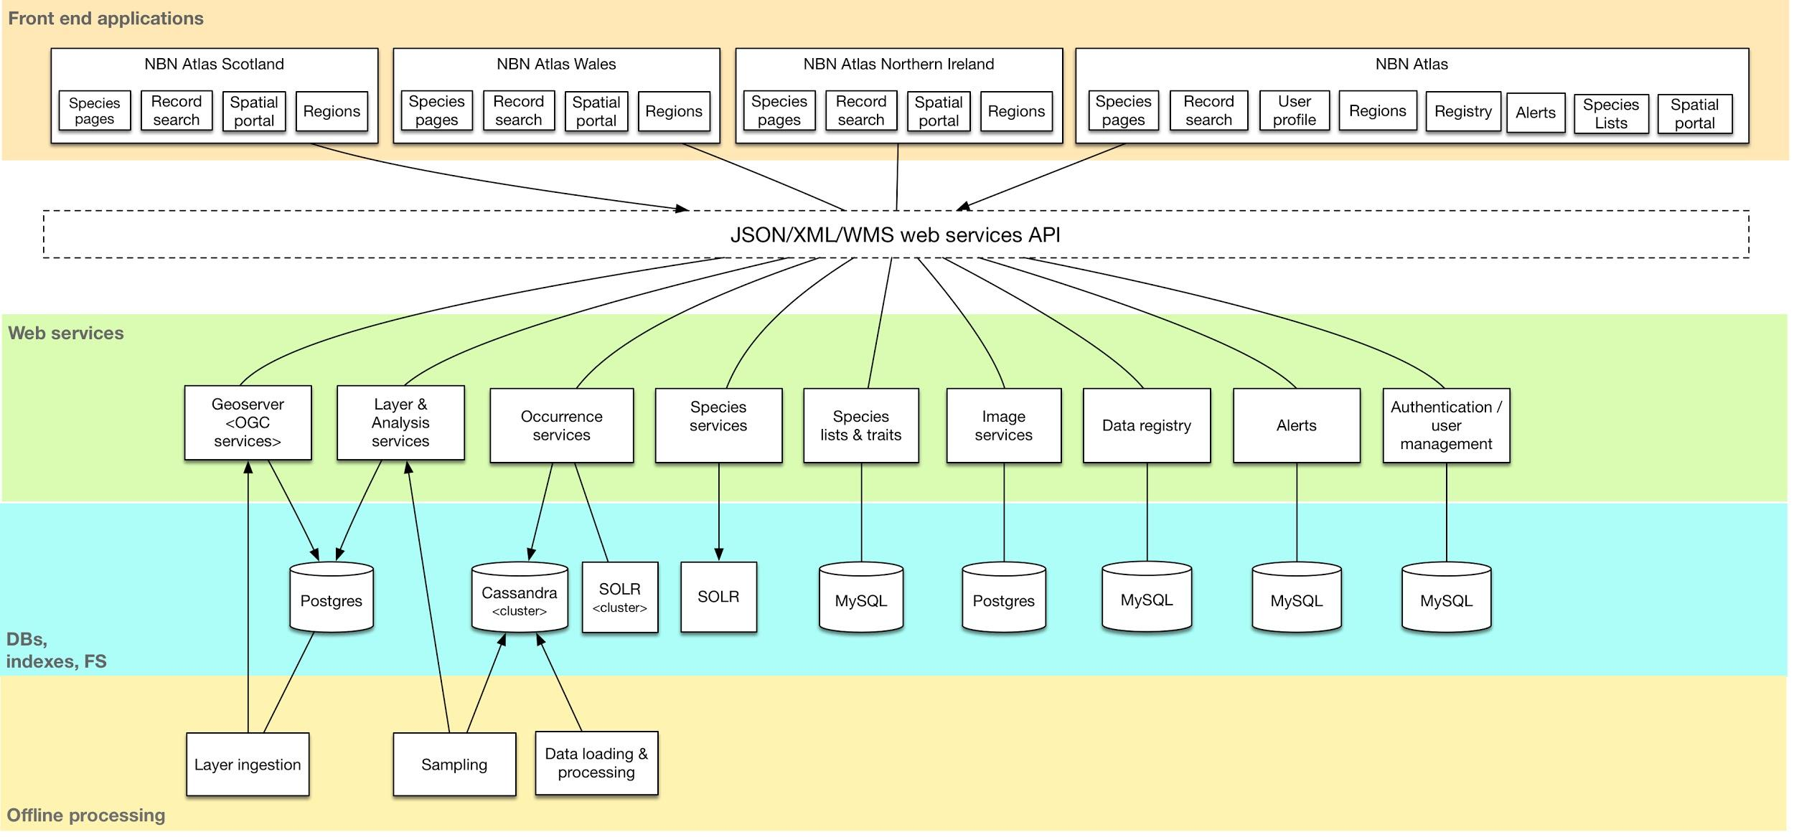

Slide 9
Biocache - occurrence searching
Query context
Demo queries in biocache
“fq=”
Configured in external configuration file
/data/ala-hub/config/ala-hub-config.properties

Slide 10
BIE - species pages
Query context
Load DwCA
Extensible - support for adhoc fields
Support for “Distribution” extension
Example query
“fq=distribution:Scotland”
Configured in external configuration file
/data/ala-bie/config/ala-bie-config.properties

Slide 11
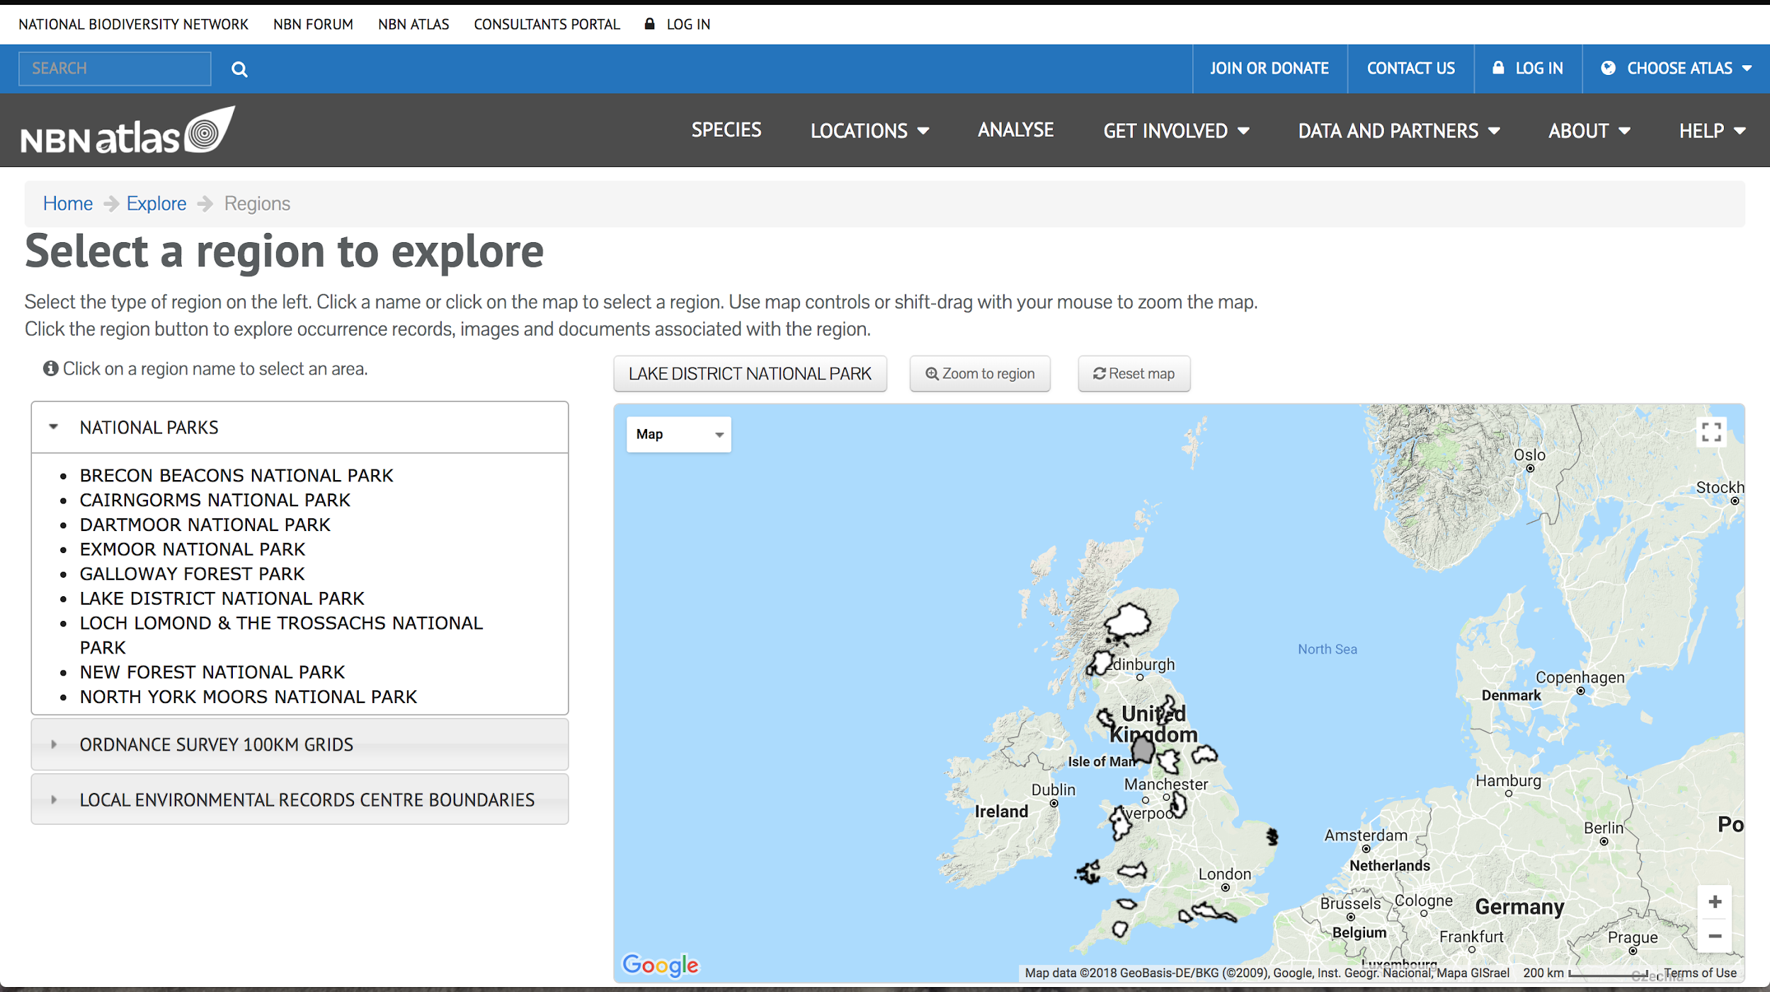
Regions
Configuration file
Menu structure

Slide 12
Thematic
Groupings of data resources
Configured in the collectory
Examples in Australia
OZCAM - Zoological collections
AVH - Herbaria

