Slide 1

GBIF publishing
GBIF CESP Workshop, Madrid 2018
Dave Martin

Slide 2
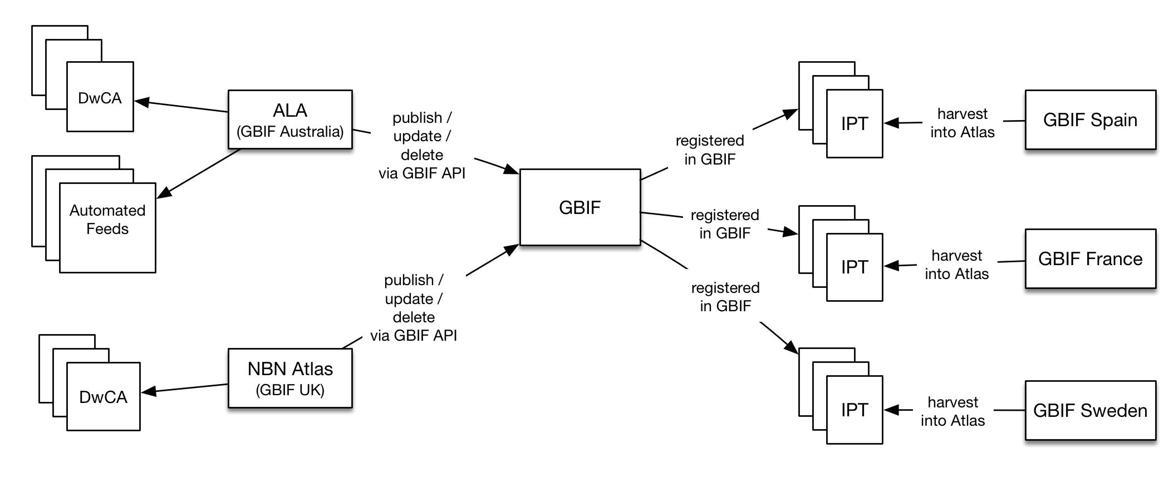

Slide 3
Demo
GBIF healthcheck
Licence configuration
Data providers / Institution publishing
Data resource

Slide 4
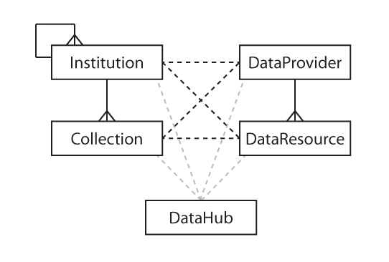
Collectory
Data resources
Collection
Institution
Data provider
Data hub

Slide 5
Publishing
Used by ALA & NBN UK
Alternative to IPT
Sensitive data
Demo

Slide 6
Publishing
Adds DOI
Visible on collectory page

