Slide 1

Species pages
Francisco Pando
  Unidad de Coordinación, nodo español de GBIF (Global Biodiversity Information Facility) / CSIC

Slide 2
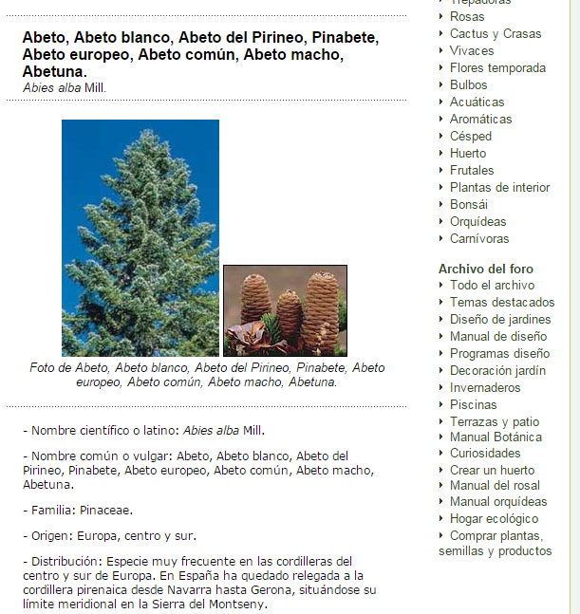
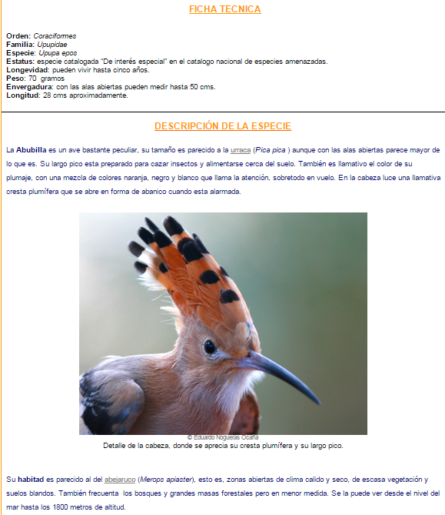
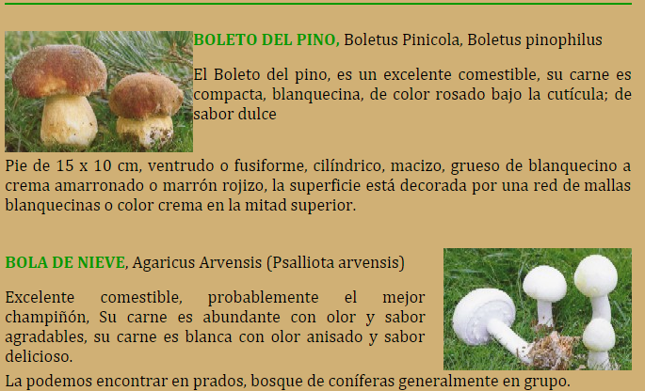

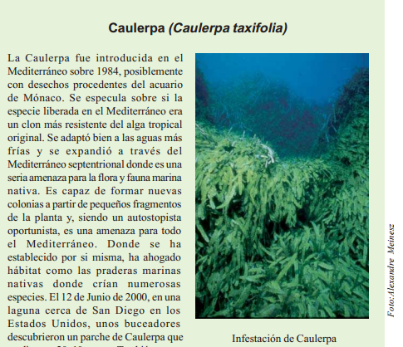
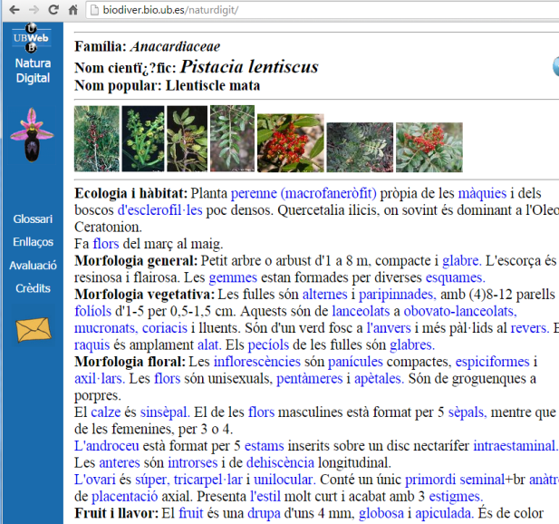
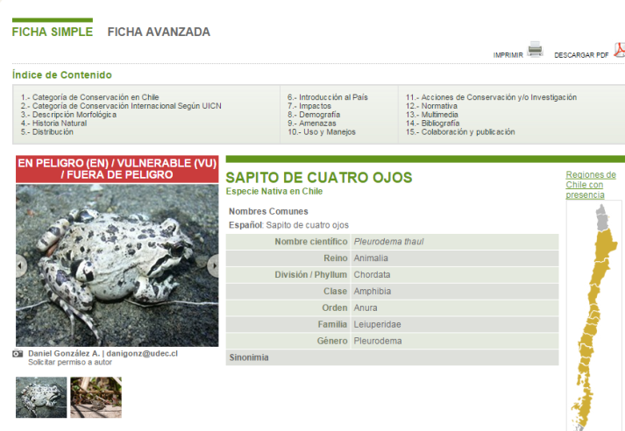
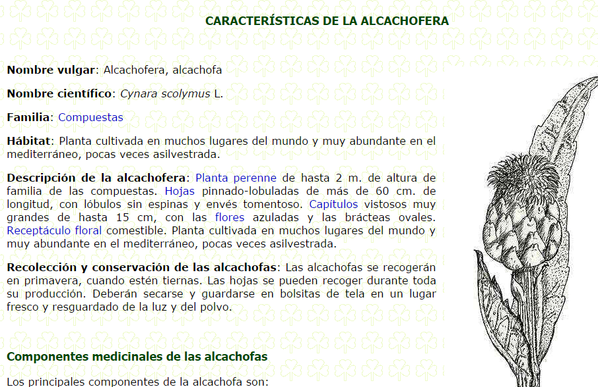

Slide 3
“Species bank will be the main access point for the wide variety of potential users of GBIF; it is the sexiest component of biodiversity data”

Slide 4
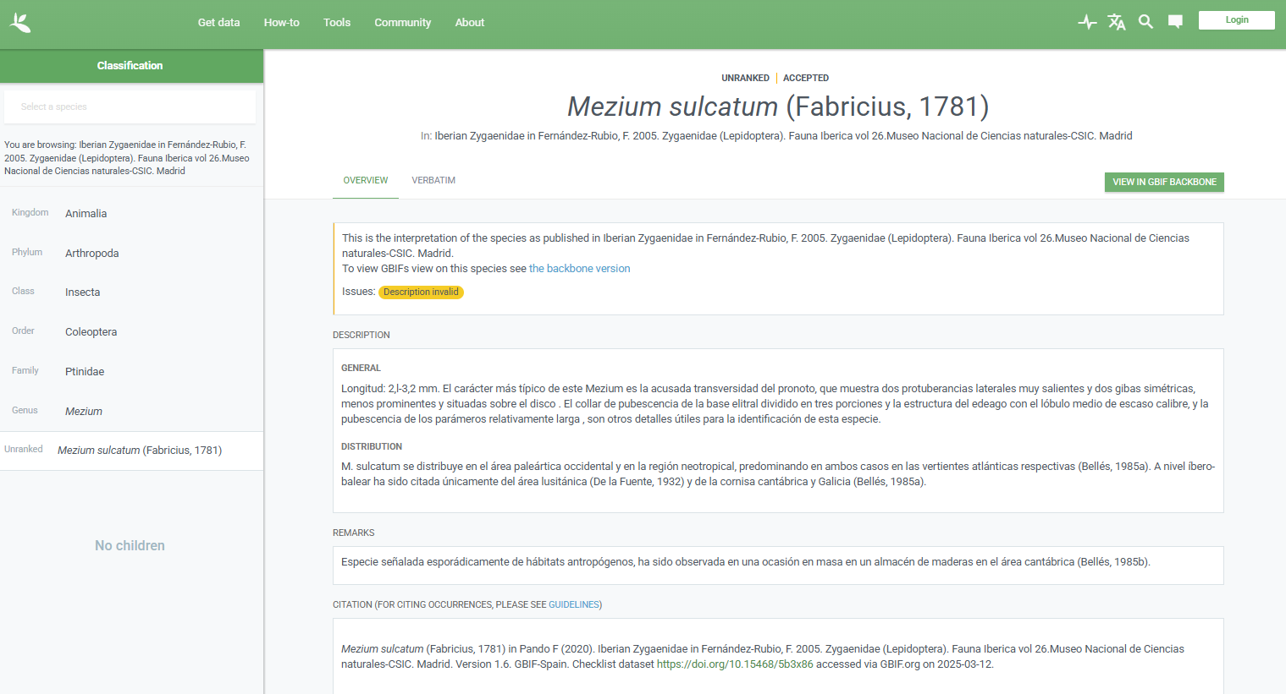
Species page in GBIF.ORG
https://www.gbif.org/species/100202687

Slide 5
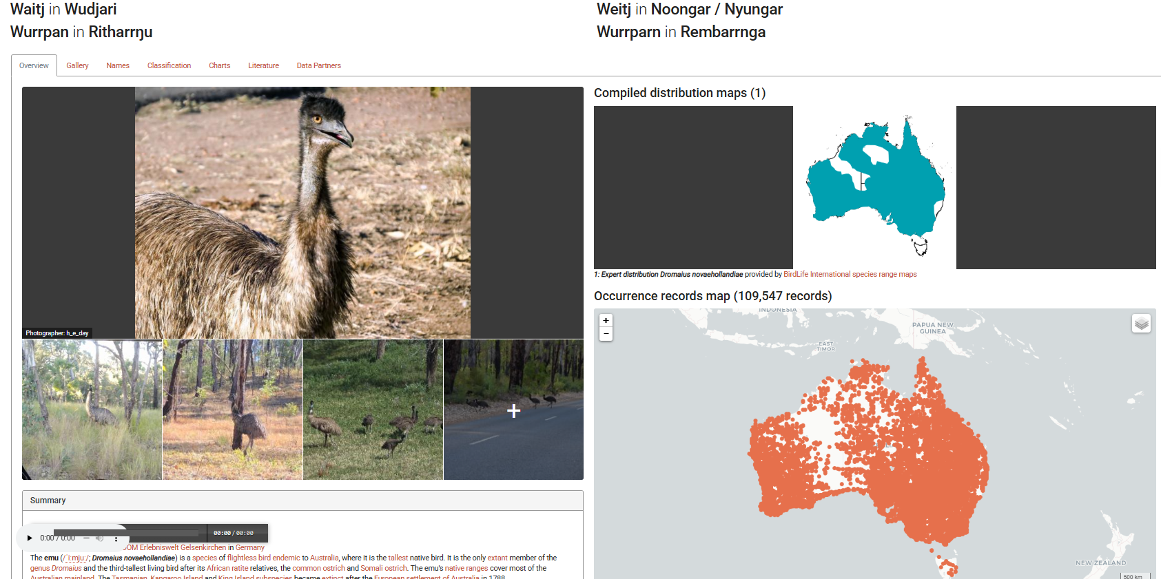
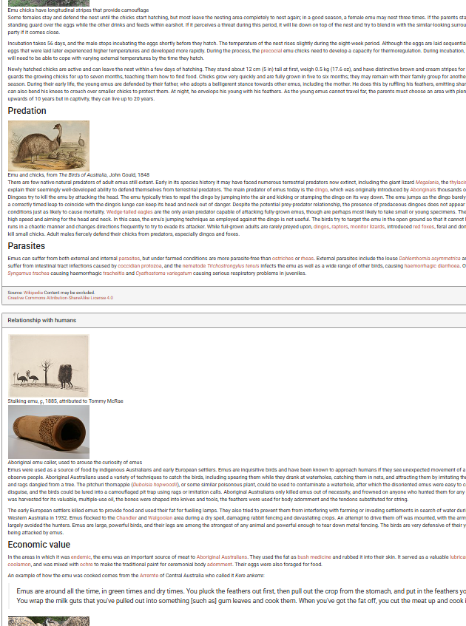
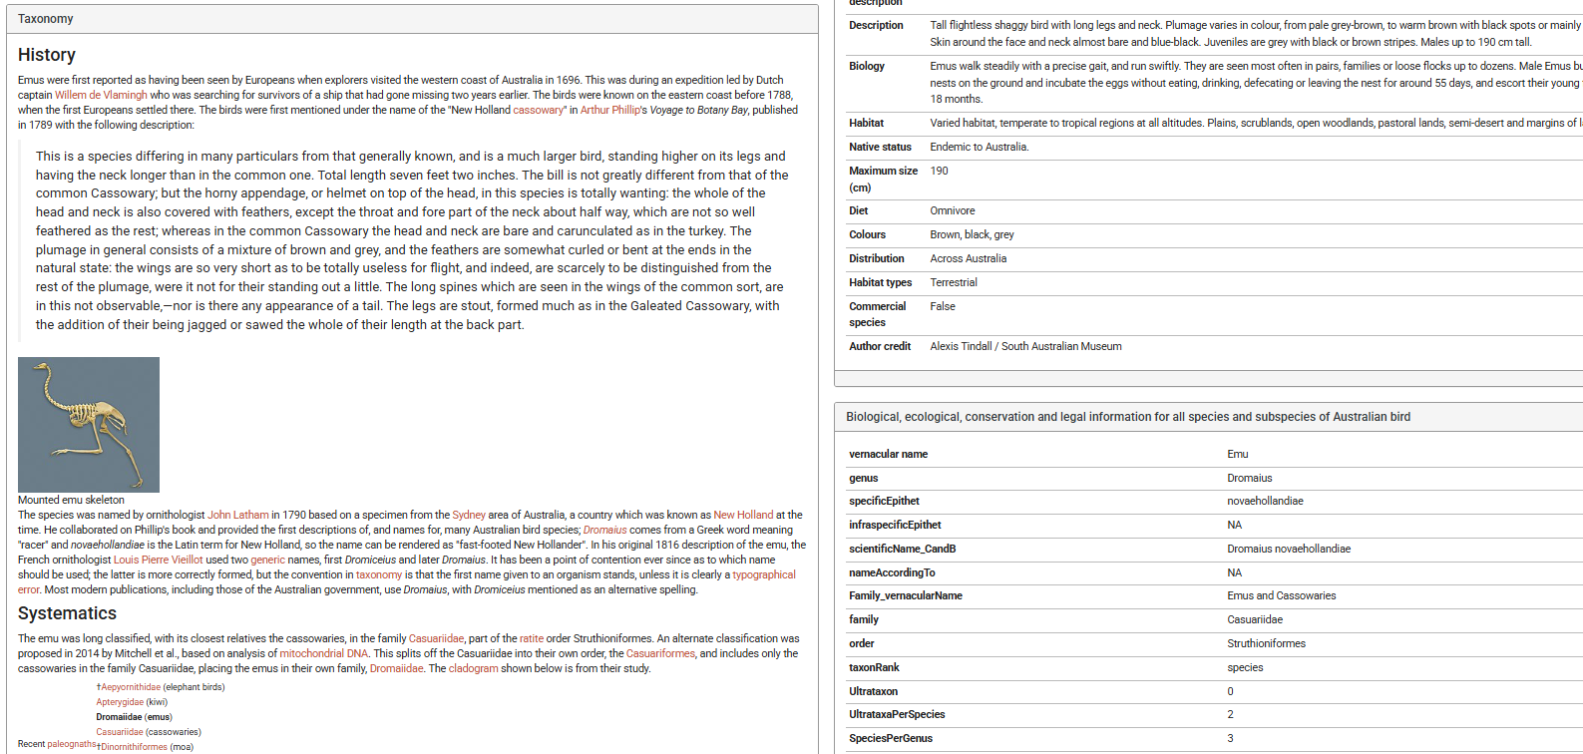
Species pages in ALA
https://bie.ala.org.au/species/https://biodiversity.org.au/afd/taxa/2a4e373b-913a-4e2a-a53f-74828f6dae7e

Slide 6
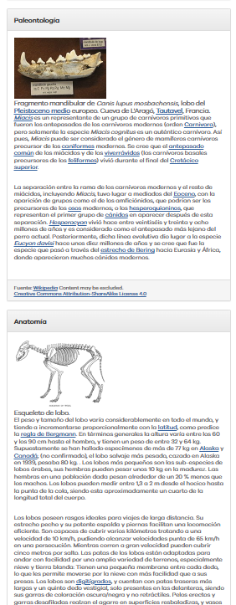
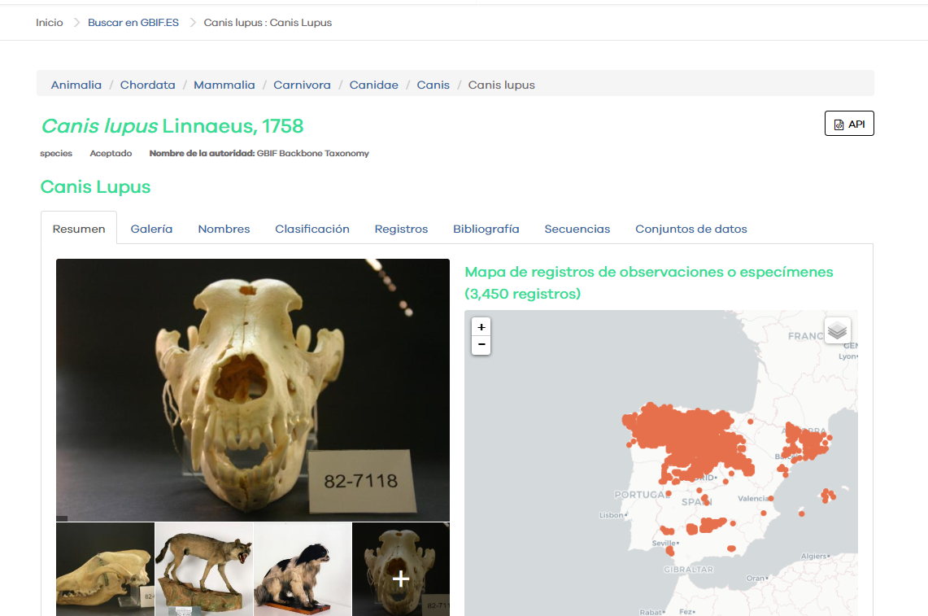
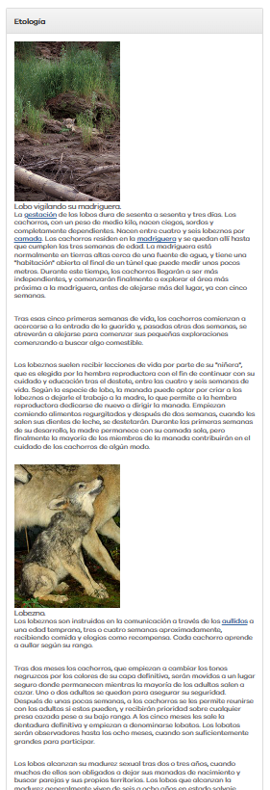
Species pages in species.gbif.es
https://especies.gbif.es/species/5219173#overview

Slide 7
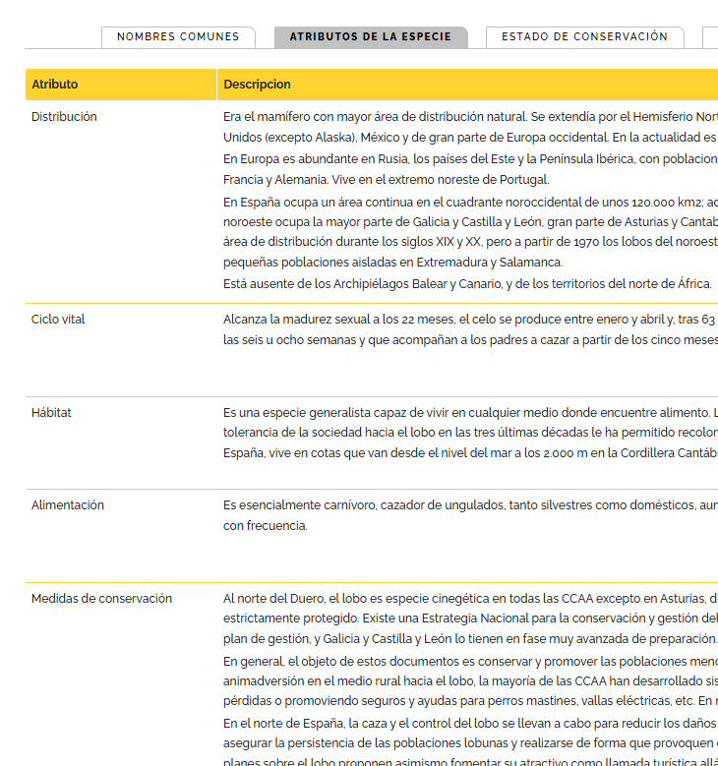
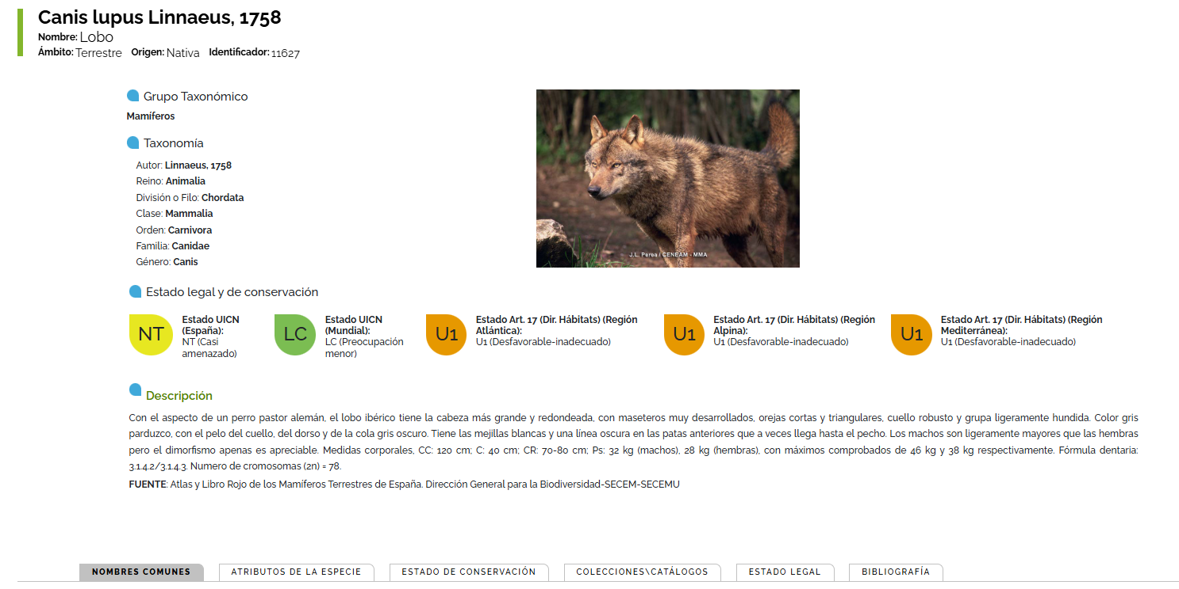
Species pages in the Spanisn Ministry for the Ecological Transition
https://iepnb.gob.es/areas-tematicas/especies-silvestres/eidos/11627/canis-lupus-linnaeus-1758

Slide 8
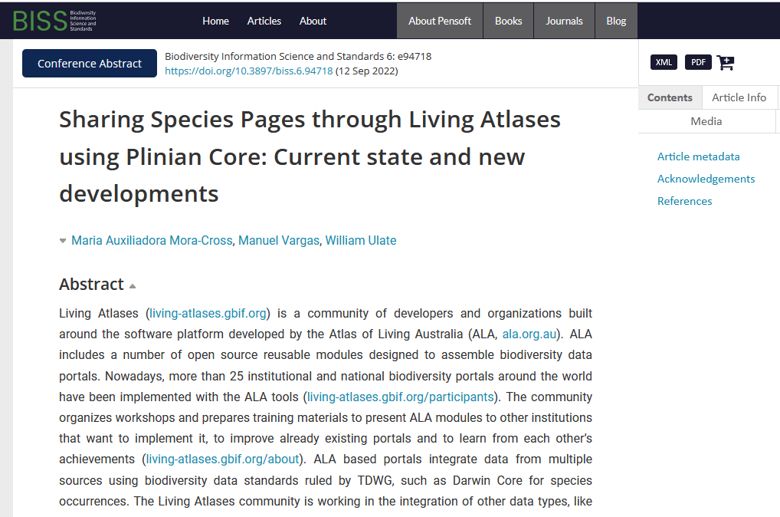
https://doi.org/10.3897/biss.6.94718

Slide 9
Species pages in… summary
They are needed
Attention to the sources is a must
A more elaborated data specification for BIE would be nice, including support for non biological features

Slide 10
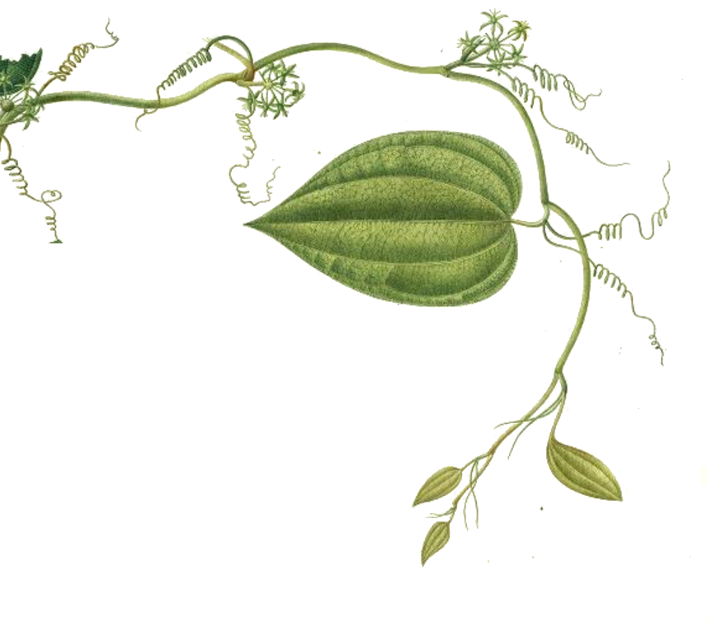





  Francisco Pando
  Unidad de Coordinación de GBIF.ES
  CSIC
  Joaquín Costa 22, 28002 Madrid
  pando@gbif.es
  https://creativecommons.org/licenses/by/4.0/deed.es
GBIF.ES is the National Biodiversity Information Node, sponsored by the Ministry of Science, Innovation and Universities, and managed by the Spanish National Research Council (CSIC). https://www.gbif.es/
https://www.gbif.es/ , https://datos.gbif.es, https://elearning.gbif.es
https://mutis.rjb.csic.es

